Slide 1
Binary Trees
By
Rachit Bundela Priya Jain Sachin Hegde

Slide 2
Introduction
Trees:Unlike Arrays, Linked Lists, Stack and queues, which are linear data structures, trees are hierarchical data structures.
Binary Tree: A tree whose elements have at most 2 children is called a binary tree. Since each element in a binary tree can have only 2 children, we typically name them the left and right child.
A Tree node contains following parts:
Data
Pointer to left child
Pointer to right child

Slide 3
Important Terms
Path : Path refers to the sequence of nodes along the edges of a tree.
Root : The node at the top of the tree is called root. There is only one root per tree and one path from the root node to any node.
Parent : Any node except the root node has one edge upward to a node called parent.
Child : The node below a given node connected by its edge downward is called its child node.
Leaf : The node which does not have any child node is called the leaf node.
Levels : Level of a node represents the generation of a node. If the root node is at level 0, then its next child node is at level 1, its grandchild is at level 2, and so on.

Slide 4
Types Of Binary Trees
The following are common types of Binary Trees.
Full Binary Tree A Binary Tree is a full binary tree if every node has 0 or 2 children.We can also say a full binary tree is a binary tree in which all nodes except leaf nodes have two children.
Complete Binary Tree: A Binary Tree is a complete Binary Tree if all the levels are completely filled except possibly the last level and the last level has all keys as left as possible.
Perfect Binary Tree :A Binary tree is a Perfect Binary Tree in which all the internal nodes have two children and all leaf nodes are at the same level.
Balanced Binary Tree:A binary tree is balanced if the height of the tree is O(Log n) where n is the number of nodes. For Example, the AVL tree maintains O(Log n) height by making sure that the difference between the heights of the left and right subtrees is almost 1.

Slide 5
Segment Tree
Let us consider the following problem to understand Segment Trees.
We have an array arr[0 . . . n-1]. We should be able to
Find the sum of elements from index l to r where 0 <= l <= r <= n-1
Change value of a specified element of the array to a new value x. We need to do arr[i] = x where 0 <= i <= n-1.
A simple solution is to run a loop from l to r and calculate the sum of elements in the given range. To update a value, simply do arr[i] = x. The first operation takes O(n) time and the second operation takes O(1) time.
What if the number of query and updates are equal? Can we perform both the operations in O(log n) time once given the array? We can use a Segment Tree to do both operations in O(Logn) time.

Slide 6
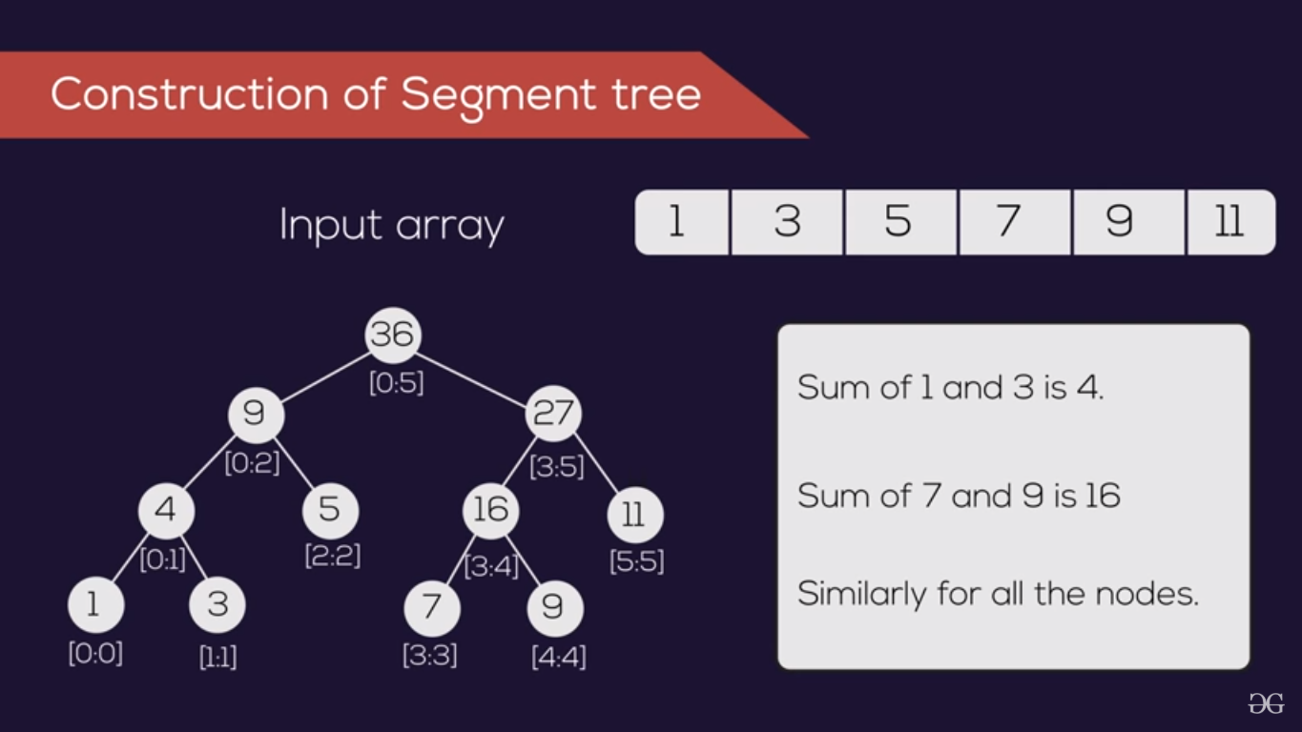

Slide 7
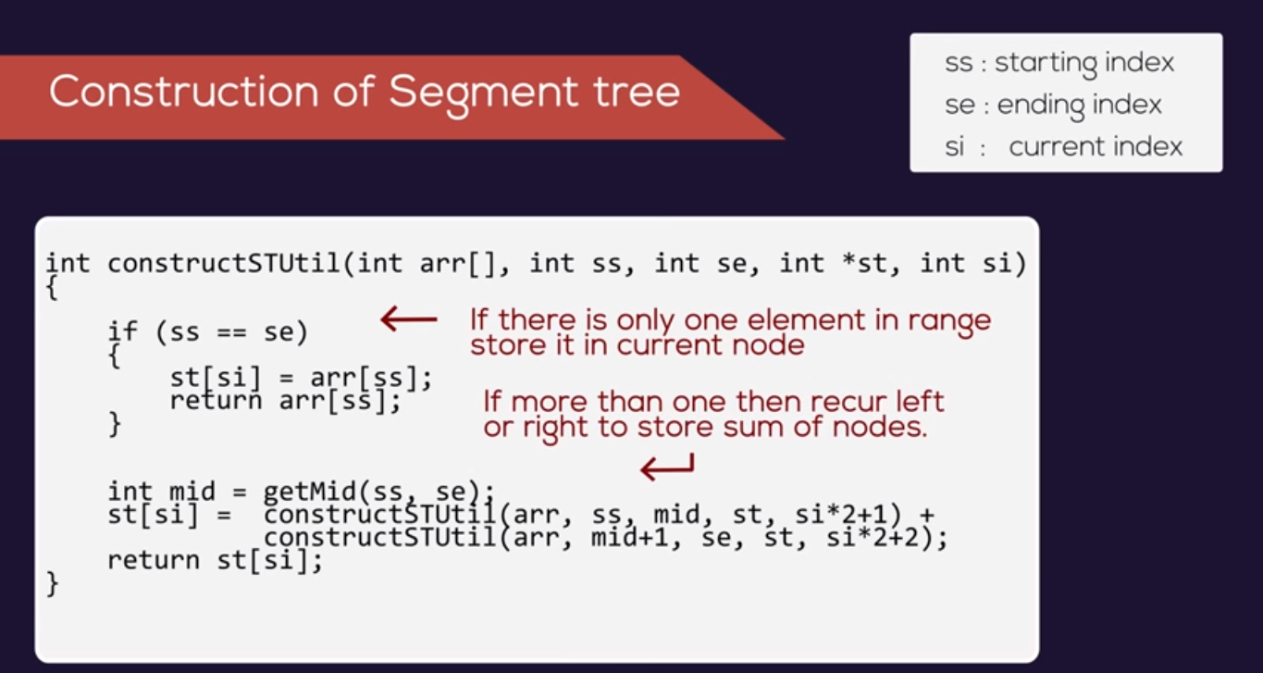

Slide 8
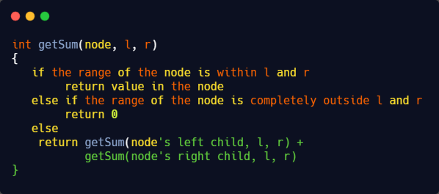
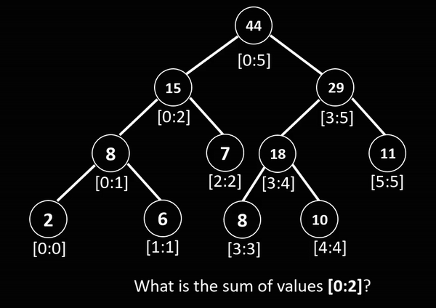
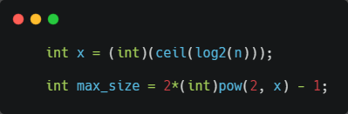

Slide 9
Threaded Binary Tree
Inorder traversal of a Binary tree can either be done using recursion or with the use of a auxiliary stack.The idea of threaded binary trees is to make inorder traversal faster and do it without stack and without recursion. A binary tree is made threaded by making all right child pointers that would normally be NULL point to the inorder successor of the node.
There are two types of threaded binary trees.
Single Threaded: Where a NULL right pointers is made to point to the inorder successor (if successor exists)
Double Threaded: Where both left and right NULL pointers are made to point to inorder predecessor and inorder successor respectively. The predecessor threads are useful for reverse inorder traversal and postorder traversal.

Slide 10
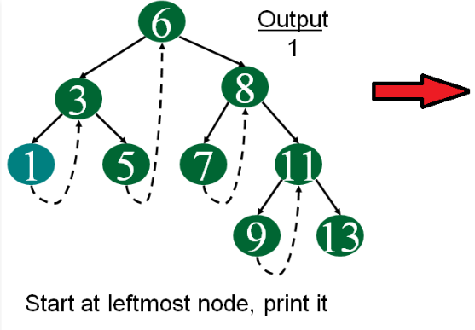
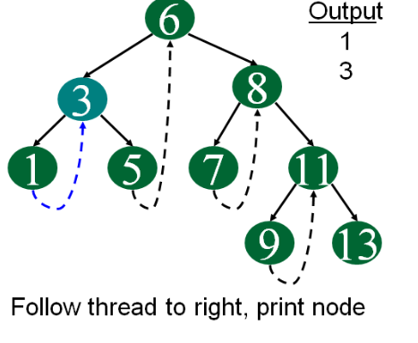
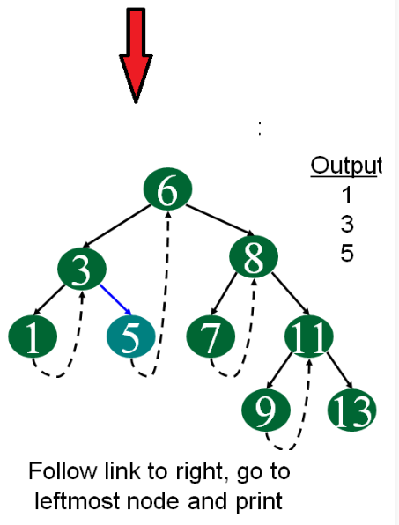
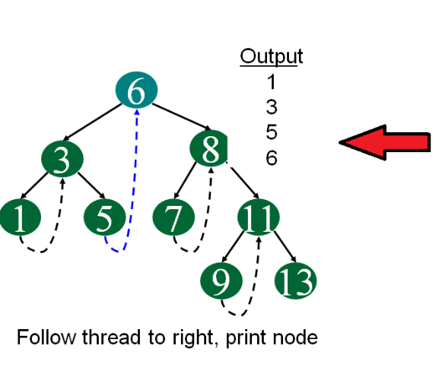
Inorder Traversal

Slide 11
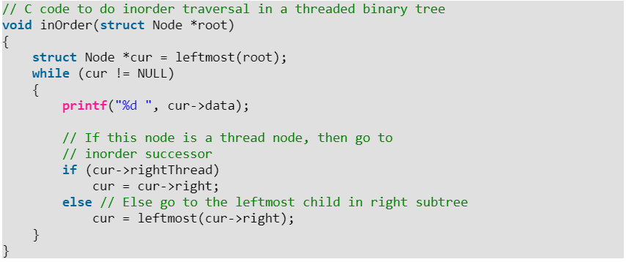
Inorder Traversal using Threads

Slide 12
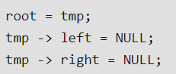
Threaded Binary Tree | Insertion
Insertion in Binary threaded tree is similar to insertion in binary tree but we will have to adjust the threads after insertion of each element.
In the following explanation, we have considered Binary Search Tree (BST) for insertion as insertion is defined by some rules in BSTs.
Let tmp be the newly inserted node. There can be three cases during insertion:
Case 1: Insertion in empty tree:Both left and right pointers of tmp will be set to NULL and new node becomes the root.

Slide 13
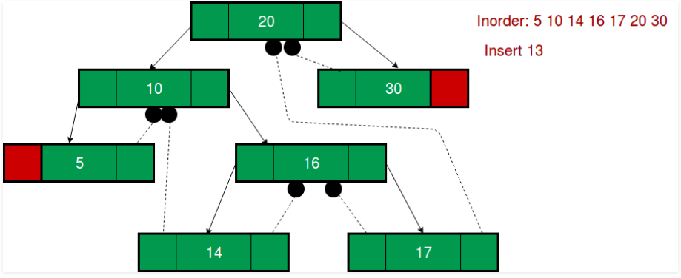
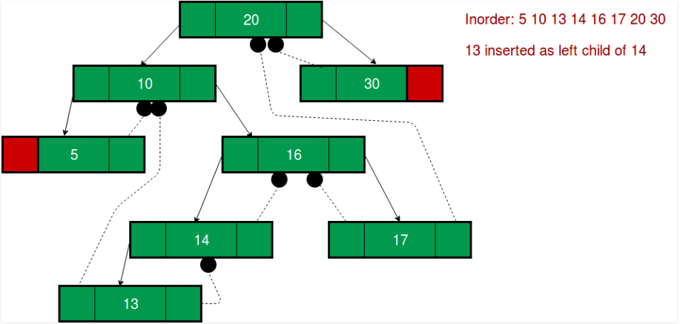
Case 2: When new node inserted as the left child:
Case 3: When new node is inserted as the right child

Slide 14

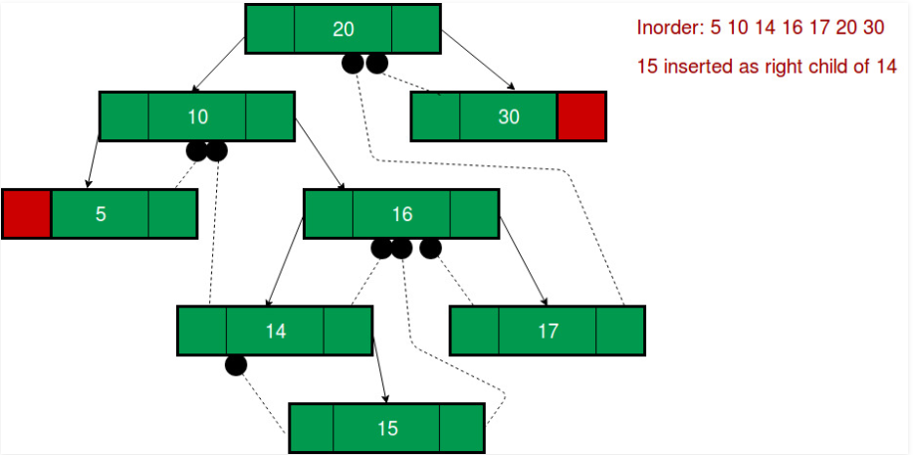

Slide 15
Binary tree to Logical OR
Given a Binary Tree, where each node has value either 0 or 1. We need to convert the given Binary tree to a tree that holds Logical OR property.
Example:
Input:
1
/ \
0 0
/ \ / \
0 1 1 1
Inorder traversal of Input:
0 0 1 1 0 1 1
Output:
1
/ \
1 1
/ \ / \
0 1 1 1
Inorder traversal of output:
0 1 1 1 1 1 1

Slide 16
Approach
At first, we need to traverse in given binary tree in postorder fashion. Because, In postorder traversal both the children of the root has already been visited before the root itself.
For each node check (recursively) if the node has one children then we don’t have any need to check else if the node has both the child then simply update the node data with the logic OR of its child data.
Algorithm:
bt_to_OR(current_node)
Step 1: Check If current_node is NULL, If it is NULL return. else continue to Step 2.
Step 2: Call bt_tp_OR() with left node of the current_node as well as Right node of the current_node.
Step 3: Check if the current_node is Leaf node. If not then, modify the current node value by doing Logical OR operation of it’s children(Left and right Child).

Slide 17
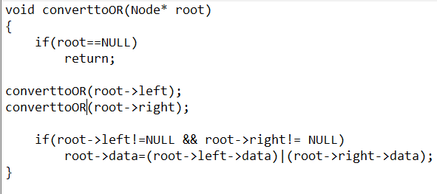
Implementation

Slide 18


